Slide 1
About this lecture....
This lecture covers some of the techniques to enhance the performance of CPU.
Then we will discuss the Instruction Prefetching
We will then discuss performance enhancement through Cache memories and multiple functional units.
We will discuss the interconnection and signals for a system bus.

Slide 2
Performance Enhancement
CPU performance can be increased by number of ways.
Instruction Prefetch:
  Fetching of next instruction simultaneously with decoding or executing current instruction.
Instruction prefetching speeds up computation.
Used in most architectures today.

Slide 3
Cache memory
Wide difference in speeds of CPU and main memory.
Impossible to get information required by CPU from main memory in one clock cycle.
  CPU has to be idle.
To avoid this, high speed caches are used to store data and instructions (transferred from main memory).
CPU has to access main memory when data is not found in the cache.
When the data is not found in the cache, it is called a cache miss.

Slide 4
A Typical CPU
Most of the typical CPUs today have the following features.
They have two separate caches, one for stor ing instructions called instruction cache or I-cache. The other cache data cache or D-cache is for storing data.
They have separate units for arithmetic operations dealing with integers and floating point (or real) numbers. The two units are known as Integer unit and Floating Point unit.
There may be more than one floating point units.
Various units of CPU are connected with the System Bus through an interface known as Bus Interface.

Slide 5
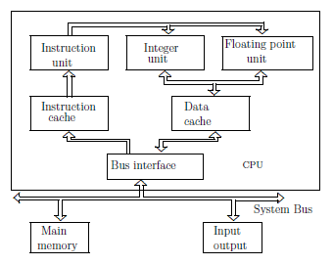
The block diagram of a typical CPU

Slide 6
About this lecture..
In this lecture, we will study
  What is cache memory?
  What are its basic characteristics?
  How can we map between cache memory and primary memory?
  How can we write in to cache memory?
  How can we initialize the cache memory?

Slide 7
Speeding up the Memory
Memory requires some finite time for the access.
Memory access time has significant impact on the total execution time.
Reduction in effective memory access is desirable.
Memory with low access time are expensive.

Slide 8

Memory Hierarchy Properties:
Three fundamental properties for designing an efficient memory hierarchy:
• Inclusion
• Coherence
Same information at all levels.
Write-through (mainly for on-chip I-cache and D-cache)
Write-back (Off-chip cache)
Memory/cache replacement policies.
• Locality of Reference:
1. Temporal locality: favours LRU replacement
2. Spatial locality assists in determining the size of unit data transfer
3. Sequential locality affects the determination of grain size for optimal scheduling and also affects prefetch techniques.

Slide 9

Memory Capacity Planning:
Performance of a memory hierarchy determined by effective access time which depends on hit ratio and access frequencies at successive levels.
Hit ratio h_{i} at level i: Probability of finding
information item at level i.
h₀=0, h_{n}=1.
Access frequency to M_{i}:

Slide 10


Effective Access Time:
Hierarchy Optimization:
Minimize T_{eff} subject to

Slide 11
Example: 3-level memory hierarchy
Cache: h₁ = 0.98, t₁ = 25ns, s₁ = 512KB, c₁ = $1.25/KB
Main memory: h₂ = 0.90, t₂ = Unknown, s₂ = 32MB, c₂ = $0.2/KB
Disk Array : h₃ = 1, t₃ = 4ms, s₃ = Unknown, c₃ = $0.0002/KB
Cost upper bound = $ 15000.
Target T_{eff} = 10.04μs
15000 = 1.25*512+0.2*32*1000+0.0002s₃
s₃ = 39.8GB
T_{eff} = 10.04 * 10⁻⁶ = 0.98 * 25 * 10⁻⁹ + 0.020.9 * t₂ + 0.02 * 0.1 * 4 * 10⁻³
t₂=903 ns

Slide 12
Cache Memory
Consider two types of memories. Assume that fast memories require 10ns for access time, slow require 80 ns for access.
A program requires 1000 memory accesses.
Using slow memories alone, time for memory access time is 80 μs (80 ns * 1000).
Using fast memories alone, time for memory accesses is 10 μs (10 ns * 1000).
Using a mixed design where 90% of accesses are met from the fast memory, the time required is (900 × 10 ns + 100 × 80 ns) = 17μs.

Slide 13
Cache Memory
At any given interval of time, only a few localized areas in the memory are referred. This phenomenon is called Locality of Reference.
Due to this phenomenon, the portions of program repeatedly referred for execution can be kept in a small but fast memory known as Cache.
It reduces the average access time.

Slide 14
Cache Memory
Basic Operation
  CPU sends the read request.
  Cache is checked whether it contains the word or not.
  If it is, then the word is read from the cache.
  If not, the primary memory is accessed to get the block in the cache.

Slide 15
Cache Memory
Hit occurs when CPU generates a read request and finds the word in cache
Miss occurs when CPU generates a read request and does not find the word in cache.
Hit Ratio is ratio of number of hits to total number of requests.
It is a measure of performance of a cache.

Slide 16
Cache Blocks
A cache is divided into blocks.
A cache block is also called a cache line.
Blocking concept in cache is similar to the paging concept of virtual memory.
Cache block sizes are typically 16 bytes to 64 bytes.
Physical memory address is also divided in to two parts, block number and offset within the block.
Cache mapping is to find the address of the cache from physical block number

Slide 17
Cache Memory
Basic characteristic of a cache is the fast access.
Mapping functions transform address of primary memory to cache address.
Three widely used mapping functions are
  1. Direct Mapping
  2. Associative Mapping
  3. Set Associative Mapping
An example of cache based system
  Size of primary memory is 2^{n} bytes, size of cache is 2^{k} bytes, and that of a block size is 2^{m} bytes.
  Number of blocks in cache is 2^{k-m} and in primary memory is 2^{n-m}.

Slide 18
Placement
Block Size
Address
SRAM Cache
Address Range
  Exceeds cache capacity
Map address to finite capacity
  Called a hash
  Usually just masks high-order bits
Direct-mapped
  Block can only exist in one location
  Hash collisions cause problems
Index
Hash
Offset
Data Out
32-bit Address
Index
Offset

Slide 19
Direct Mapping
A physical block can be found only in one cache block.
Given a block b in physical memory, its corresponding cache block is b mod 2^{l} where the cache has 2^{l} blocks in total.
Since more than one physical block may map on to the single cache block, cache blocks needs to store the physical block number.
This is stored in field called ‘tag’ with each cache block.
Tag also stores whether the cache block holds a valid physical block or not.

Slide 20
Direct Mapped Cache
Easy to implement
  Cache block is found by (physical block) mod (number of cache blocks).
  Hit or miss can be detected by matching tag with the physical block number.
Poor hit ratio
  What if memory accesses are consecutively from page 0 and page 4? Each access results in a miss.

Slide 21
Fully Associative Mapping
A block from primary memory can reside anywhere in the cache.
In order to find where a physical block is, all cache block tags need to be searched.
Associative memories can be used for this purpose.
Associative memories also allow a search function, wherein given a data, memory provides the address where data is found.
Upon a miss, physical block is brought to the cache in any empty slot.
If cache is not empty, replacement algorithm is used to make room for the block.

Slide 22
Identification
Tag
Address
?=
SRAM Cache
Fully-associative
  Block can exist anywhere
  No more hash collisions
Identification
  How do I know I have the right block?
  Called a tag check
    Must store address tags
    Compare against address
Expensive!
  Tag & comparator per block
Hit
Hash
Tag Check
Offset
Data Out
32-bit Address
Tag
Offset

Slide 23
Fully Associative Mapping
Slow for checking if block is in the cache or not.
Associative memories are difficult to make and costly.
Advantage is that any cache block can house any physical block.

Slide 24
Set Associative Mapping
Combination of direct and fully associative mapping.
Blocks of cache are divided in to sets of equal size.
A block of primary memory is mapped to a set and is allowed to reside in any block within the set.
In case of a miss, the block from primary memory is transferred to cache. And, if the corresponding set is full, a replacement algorithm is used to get a room in the cache.

Slide 25
Placement
Address
SRAM Cache
Set-associative
  Block can be in a locations
  Hash collisions:
    a still OK
Identification
  Still perform tag check
  However, only a in parallel
Index
Index
Hash
a Tags
a Data Blocks
?=
?=
Tag
?=
?=
Offset
32-bit Address
Data Out
Tag
Index
Offset
© 2005 Mikko Lipasti

Slide 26
Set Associative Mapping
Simplicity of direct mapping cache.
  Only k entries need to be searched for a k way set associative cache.
Versatility of fully associative cache.
  More than one possibility for physical block.
Studies show k =2 or 3 is enough for a good cache performance.

Slide 27
Cache Memory
Cache Initialization is done as follows:
  Valid bit is attached to each block in cache.
  Initially valid bits are set to 0 to indicate that cache contains invalid data.
  Whenever a block is brought to cache, valid bit is set to 1.

Slide 28
Replacement
Cache has finite size
  What do we do when it is full?
Analogy: desktop full?
  Move books to bookshelf to make room
  Bookshelf full? Move least-used to library
  Etc.
Same idea:
  Move blocks to next level of cache

Slide 29
Cache Miss Rates: 3 C’s [Hill]
Compulsory miss or Cold miss
  First-ever reference to a given block of memory
  Measure: number of misses in an infinite cache model
Capacity
  Working set exceeds cache capacity
  Useful blocks (with future references) displaced
  Good replacement policy is crucial!
  Measure: additional misses in a fully-associative cache
Conflict
  Placement restrictions (not fully-associative) cause useful blocks to be displaced
  Think of as capacity within set
  Good replacement policy is crucial!
  Measure: additional misses in cache of interest

Slide 30
Replacement
How do we choose victim?
  Verbs: Victimize, evict, replace, cast out
Many policies are possible
  FIFO (first-in-first-out)
  LRU (least recently used), pseudo-LRU
  LFU (least frequently used)
  NMRU (not most recently used)
  NRU
  Pseudo-random (yes, really!)
  Optimal
  Etc

Slide 31
Optimal Replacement Policy?
Evict block with longest reuse distance
  i.e. next reference to block is farthest in future
  Requires knowledge of the future!
Can’t build it, but can model it with trace
  Process trace in reverse
  describe how to do this in one pass over the trace with some lookahead (Cheetah simulator)
Useful, since it reveals opportunity
  (X,A,B,C,D,X): LRU 4-way SA , 2nd X will miss

Slide 32
Least-Recently Used
For a=2, LRU is equivalent to NMRU
  Single bit per set indicates LRU/MRU
  Set/clear on each access
For a>2, LRU is difficult/expensive
  Timestamps? How many bits?
    Must find min timestamp on each eviction
  Sorted list? Re-sort on every access?
List overhead: log₂(a) bits /block
  Shift register implementation

Slide 33
Cache Replacement Policies
Cache replacement is apply with Cache and Main Memory. When the cache is full then we replace a block (line) of cache with the main memory Block.
Page Replacement is apply with RAM and Hard Disk. When RAM is full then we replace a page of RAM with the Frame of Hard Disk.
Types of Cache replacement policies
FIFO
LRU
MRU
RANDOM

Slide 34
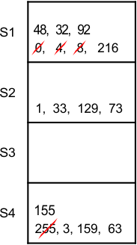

First in First out (FIFO) algorithm replaces the oldest block stored in the cache
Note: if there are 4 positions in the cache when the 5th block came in the cache then the element of
position 1 is replaced in any case.
Question 1: Consider a 4-way set associative cache with total of 16 cache blocks. Main memory block requests are
0,255,1,4,3,8,133,159,216,129,63,8,48,32,73,92,155
As 4 blocks can reside in each line at a time. So, the solution given in the following diagram

Slide 35
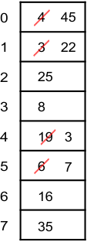
LRU
Replace the cache block, which was not used the longest period of time in the recent.
Example :1
Consider a fully associative cache with 8 cache blocks (0-7) and the following sequence of memory block requests: 4, 3, 25, 8, 19, 6, 25, 8, 16, 35, 45, 22, 8, 3, 16, 25 and 7. By using LRU, find the position of memory block 7 in the cache.
Solution: At point 45 the 8 blocks of cache are filled and no free space is available to accommodate a new block in the cache. So we check back the reference string at point 45 and replace the least recently used block in the cache which is 4 in example. And so on next incoming block is 22 which will be replaced with block no. 3.

Slide 36
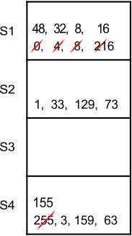
Example
: 2
Consider a 4 way set associative cache mapping with 16 cache blocks. Main memory block request are 0,255,1,4,3,8,133,159,216,129,63,8,48,32,73,92,155,16.
Solution:
Note: 4 blocks can exist in any line at a time. So

Slide 37
Not Recently Used (NRU)
Keep NRU state in 1 bit/block
  Bit is set to 0 when installed (assume reuse)
  Bit is set to 0 when referenced (reuse observed)
  Evictions favor NRU=1 blocks
  If all blocks are NRU=0
    Eviction forces all blocks in set to NRU=1
    Picks one as victim (can be pseudo-random, or rotating, or fixed left-to-right)
Provides some scan and thrash resistance
  Relies on “randomizing” evictions rather than strict LRU order

Slide 38
Write-through caches
A write-through cache forces all writes to update both the cache and the main memory. ▪ This is simple to implement and keeps the cache and memory consistent.
The bad thing is that forcing every write to go to main memory, we use up bandwidth between the cache and the memory.

Slide 39
Write-back caches
In a write-back cache, the memory is not updated until the cache block needs to be replaced (e.g., when loading data into a full cache set).
For example, we might write some data to the cache at first, leaving it inconsistent with the main memory as shown before. —The cache block is marked “dirty” to indicate this inconsistency Subsequent reads to the same memory address?
Multiple writes to same block?

Slide 40
Write Policy
Do we allocate cache lines on a write?
  Write-allocate
    A write miss brings block into cache
  No-write-allocate
    A write miss leaves cache as it was
Do we update memory on writes?
  Write-through
    Memory immediately updated on each write
  Write-back
    Memory updated when line replaced

Slide 41
Write-back Caches
Need a Dirty bit for each line
  A dirty line has more recent data than memory
Line starts as clean (not dirty)
Line becomes dirty on first write to it
  Memory not updated yet, cache has the only up-to-date copy of data for a dirty line
Replacing a dirty line
  Must write data back to memory (write-back)

Slide 42
Cache Performance
Miss rate
  Fraction of memory accesses that miss in cache
  Hit rate = 1 – miss rate
Average memory access time
  AMAT = hit time + miss rate * miss penalty
Memory stall cycles
CPUtime = CycleTime x (Cycles_{Exec} + Cycles_{MemoryStall})
Cycles_{MemoryStall} = CacheMisses x (MissLatency_{Total} – MissLatency_{Overlapped})

Slide 43
Improving Cache Performance
AMAT = hit time + miss rate * miss penalty
  Reduce miss penalty
  Reduce miss rate
  Reduce hit time
Cycles_{MemoryStall} = CacheMisses x (MissLatency_{Total} – MissLatency_{Overlapped})
  Increase overlapped miss latency

Slide 44
Reducing Cache Miss Penalty (1)
Multilevel caches
  Very Fast, small Level 1 (L1) cache
  Fast, not so small Level 2 (L2) cache
  May also have slower, large L3 cache, etc.
Why does this help?
  Miss in L1 cache can hit in L2 cache, etc.
    AMAT = HitTime_{L1}+MissRate_{L1}MissPenalty_{L1}
    MissPenalty_{L1}= HitTime_{L2}+MissRate_{L2}MissPenalty_{L2}
    MissPenalty_{L2}= HitTime_{L3}+MissRate_{L3}MissPenalty_{L3}

Slide 45
Multilevel Caches
Global vs. Local Miss Rate
  Global L2 Miss Rate
  # of L2 Misses / # of All Memory Refs
  Local Miss Rate
  # of L2 Misses / # of L1 Misses
  (only L1 misses actually get to the L2 cache)
  MPKI often used (normalize against number of instructions)
    Allows comparisons against different types of events
Exclusion Property
  If block is in L1 cache, it is never in L2 cache
  Saves some L2 space
Inclusion Property
  If block A is in L1 cache, it must also be in L2 cache

Slide 46
Reducing Cache Miss Penalty (2)
Early Restart & Critical Word First
  Block transfer takes time (bus too narrow)
  Give data to loads before entire block arrive
Early restart
  When needed word arrives, let processor use it
  Then continue block transfer to fill cache line
Critical Word First
  Transfer loaded word first, then the rest of block
  (with wrap-around to get the entire block)
  Use with early restart to let processor go ASAP

Slide 47
Reducing Cache Miss Penalty (3)
Increase Load Miss Priority
  Loads can have dependent instructions
  If a load misses and a store needs to go to memory, let the load miss go first
  Need a write buffer to remember stores
Merging Write Buffer
  If multiple write misses to the same block, combine them in the write buffer
  Use block-write instead of a many small writes

Slide 48
Reducing Cache Miss Penalty (4)
Victim Caches
  Recently kicked-out blocks kept in small cache
  If we miss on those blocks, can get them fast
  Why does it work: conflict misses
    Misses that we have in our N-way set-assoc cache, but would not have if the cache was fully associative
  Example: direct-mapped L1 cache and
  a 16-line fully associative victim cache
    Victim cache prevents thrashing when several “popular” blocks want to go to the same entry

Slide 49
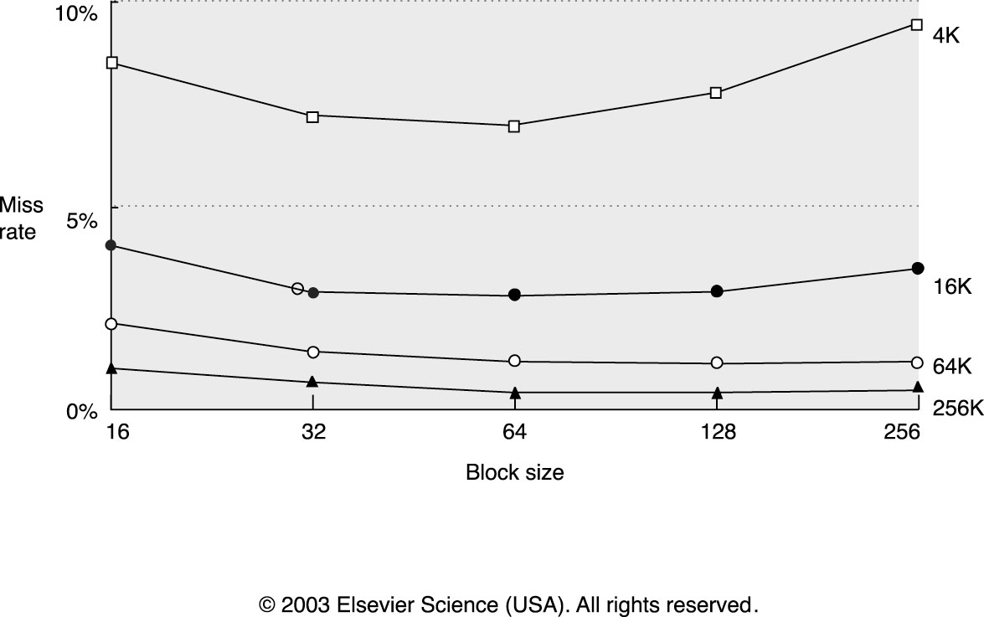
Reducing Cache Miss Rate (1)
Larger blocks
  Helps if there is more spatial locality

Slide 50
Reducing Cache Miss Rate (2)
Larger caches
  Fewer capacity misses, but longer hit latency!
Higher Associativity
  Fewer conflict misses, but longer hit latency
Way Prediction
  Speeds up set-associative caches
  Predict which of N ways has our data,
  fast access as direct-mapped cache
  If mispredicted, access again as set-assoc cache

Slide 51
Reducing Cache Miss Rate (2)
Pseudo Associative Caches
  Similar to way prediction
  Start with direct mapped cache
  If miss on “primary” entry, try another entry
Compiler optimizations
  Loop interchange
  Blocking

Slide 52
Cache Coherence Protocols:
Cache Coherency Problem:
A memory subsystem is considered coherent at the cache line level if the access to any cached copy of a cache line X in memory always returns with the following caching results:
• A read following a write of X by processor P, with no writes of X by other processors, will return value written by P.
• A read by processor P following a write of X by another processor Q will return value written by Q if the read and write are sufficiently separated and there are no writes of X by other processors in between.
• Writes to the same cache line X by different processors are always serialized to present the same order of memory events, seen by all processors.

Slide 53
Sources of Incoherence:
1. The write by different processors into their cached copies of the same cache line in memory, asynchronously.
2. Process migration among multiple processors without alerting each other.
3. I/O operations bypassing the owners of cached copies.

Slide 54
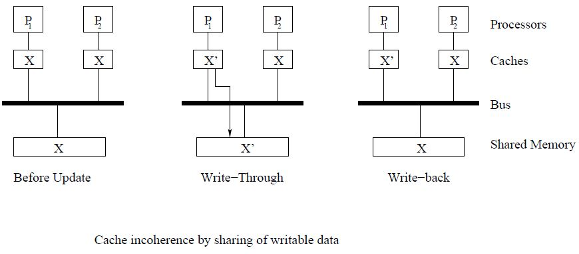
Example: Incoherent caches caused by write of shared data
Either invalidate or update the caches immediately after each cache operation.

Slide 55
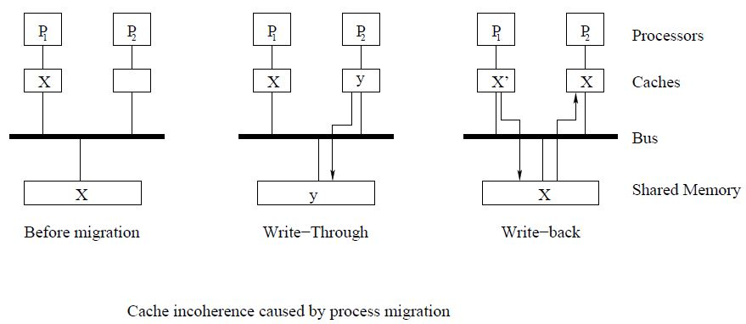
Example: Incoherent caches caused by
Process migration
Write-Through: P2 writes with new value y into the cache after a process migration from P1 to P2.
Write-back: Old value x may be migrated to cache2 with a read operation, if the migration is done ahead of the write-back operation.

Slide 56
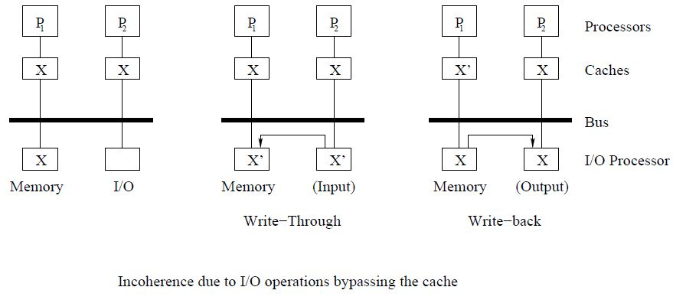
Example: Incoherent caches caused by I/O operations bypassing the owners of cached copies

Slide 57
Directory-Based Coherency Protocol
Don’t use broadcast-based snoopy protocols.
Cache Directory: Directory to record the locations and states of all cached lines of shared data.
A directory entry for each cache line of data containing dirty bit and number of pointers to specify the location of all remote copies.
Concept of central directory to record all cache conditions (including the presence information and all cache line states) suitable only for a small-scale SMP with centralized shared memory.
Central directory for large-cache SMP, NUMA or distributed memory platform would require a huge memory to implement and must be associatively searched to reduce the update time.

Slide 58
Directory-Based Coherency Protocol
Don’t use broadcast-based snoopy protocols.
Distributed Directories:
Each memory module maintains a separate directory which records the states and presence information of all cached lines. Directory entries contain the states of cache lines and the presence information with pointers to specify the location of all remote copies.

Slide 59
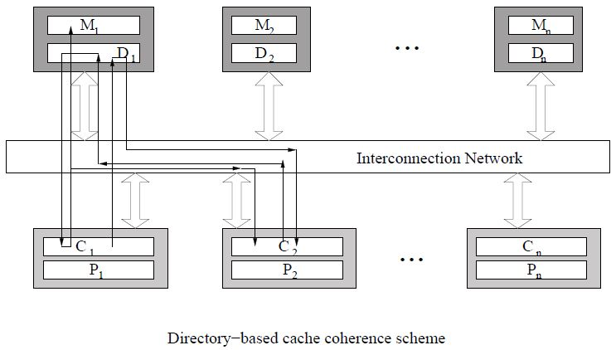
Directory-Based Coherency Protocol
Don’t use broadcast-based snoopy protocols.
Distributed Directories:
A read-miss in C2 results in a request sent to D1 that indicates the presence of a clean copy in C1. Memory controller retransmits the request to C1. This cache returns clean copy to M1 and C2. A write-hit at C1 will result in sending a command to memory controller to send invalidation signal to all caches marked in the presence bits in D1.

Slide 60
Cache Directory Structure:
Full map cache directory: Contains information of all cache lines shared on global basis. Each entry has N (no. of processors) entries. Full directory repeats in each node occupying lots of memory space.
Limited cache directory: Small fixed number of pointers per directory entry regardless of system size. Economical if memory sharing is low but may slow down the system for large sharing.
Chained cache directory: Emulation of full-map directory by distributing the directory information to small local directories.

